Slide 1
Production and Comparative Advantage
Steven Suranovic
George Washington University

Slide 2
Model Assumptions
Include all assumptions of the Pure Exchange model
Instead of an endowment, Smith and Jones must produce their apples and oranges
Their production capabilities for apple and oranges will differ
See the description below …

Slide 3
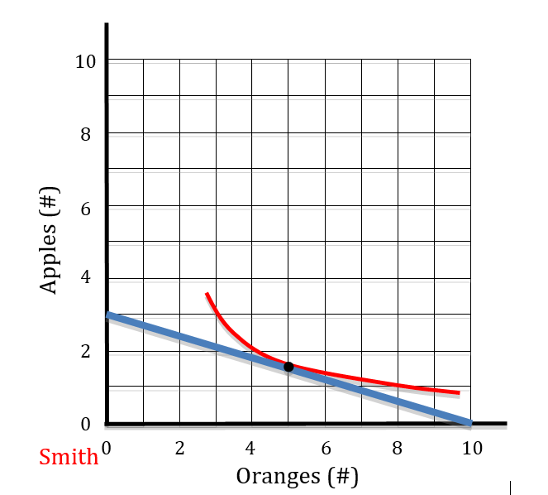
Smith’s Production Possibility Frontier
Smith is endowed with 1 hour of labor
He can produce 10 oranges in one hour
He can produce 3 apples in 1 hour

Slide 4
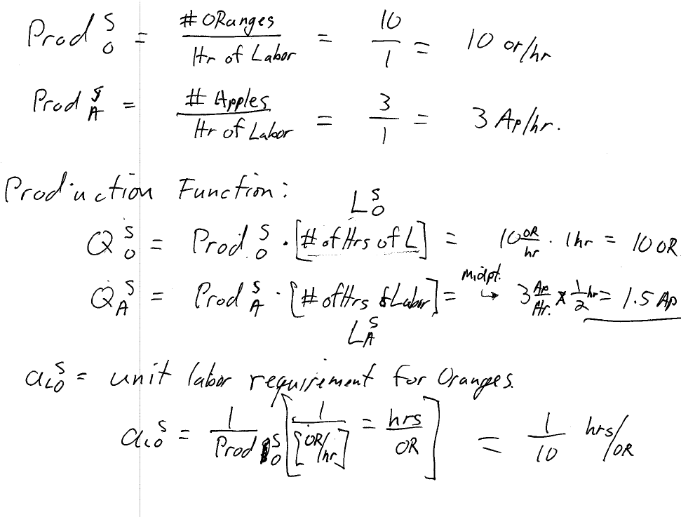

Slide 5
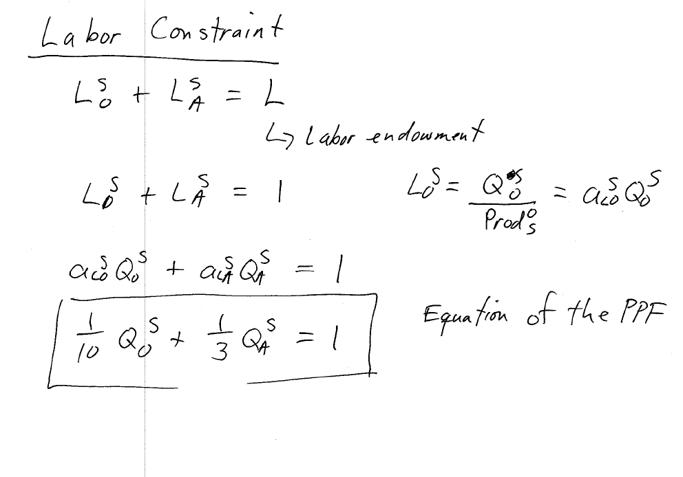

Slide 6
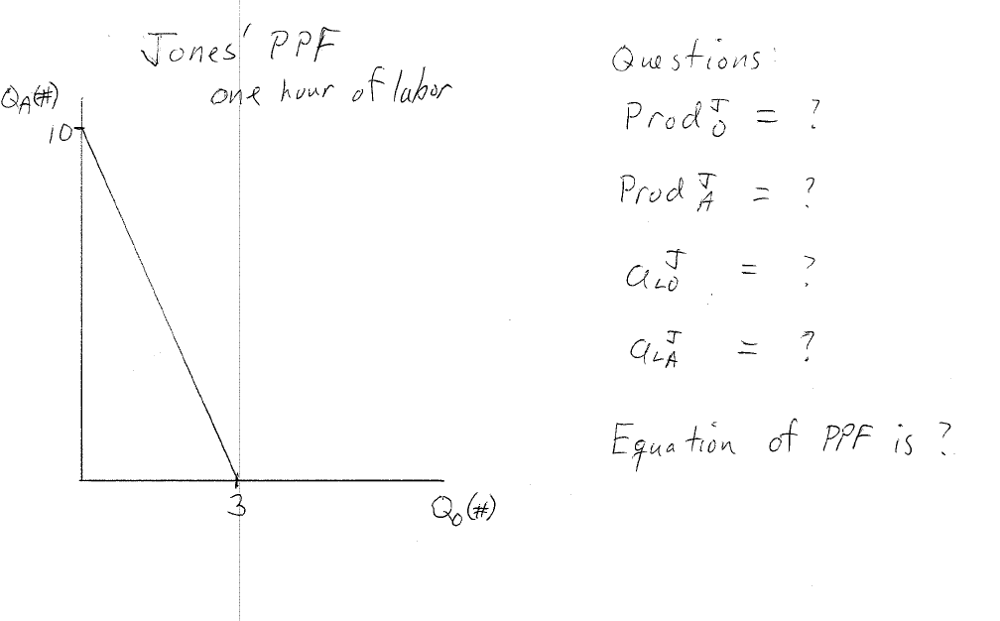
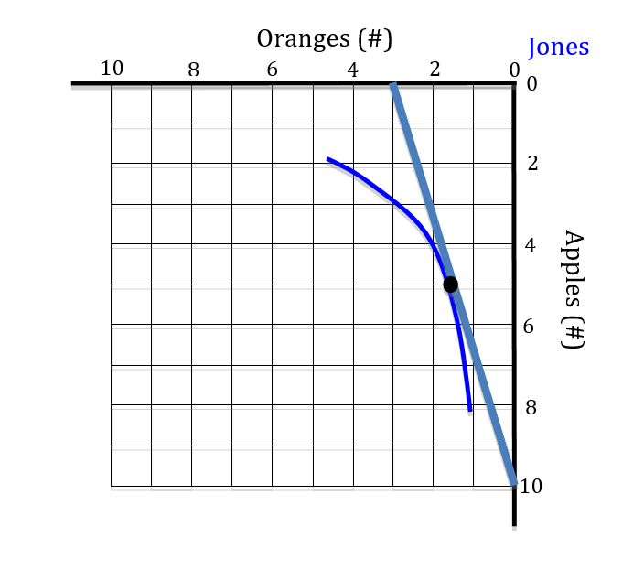

Slide 7
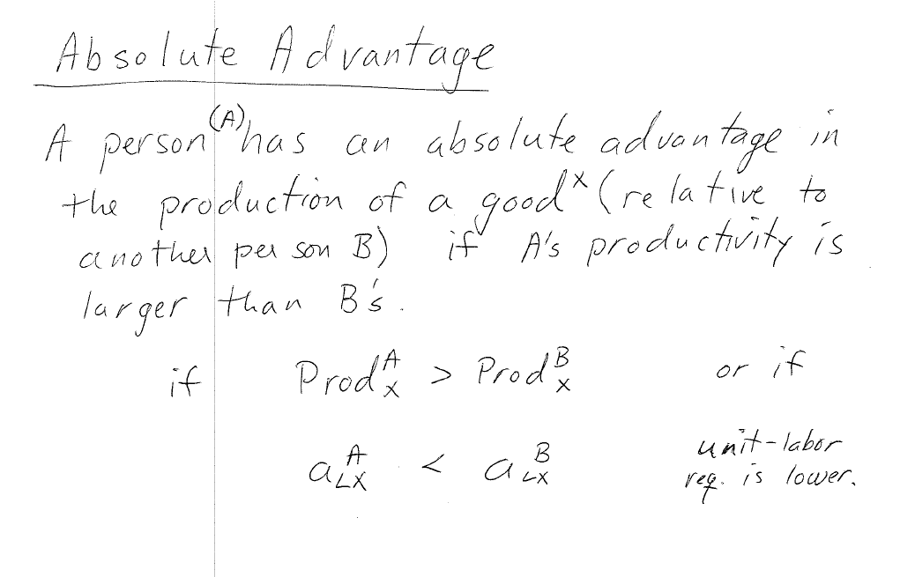

Slide 8
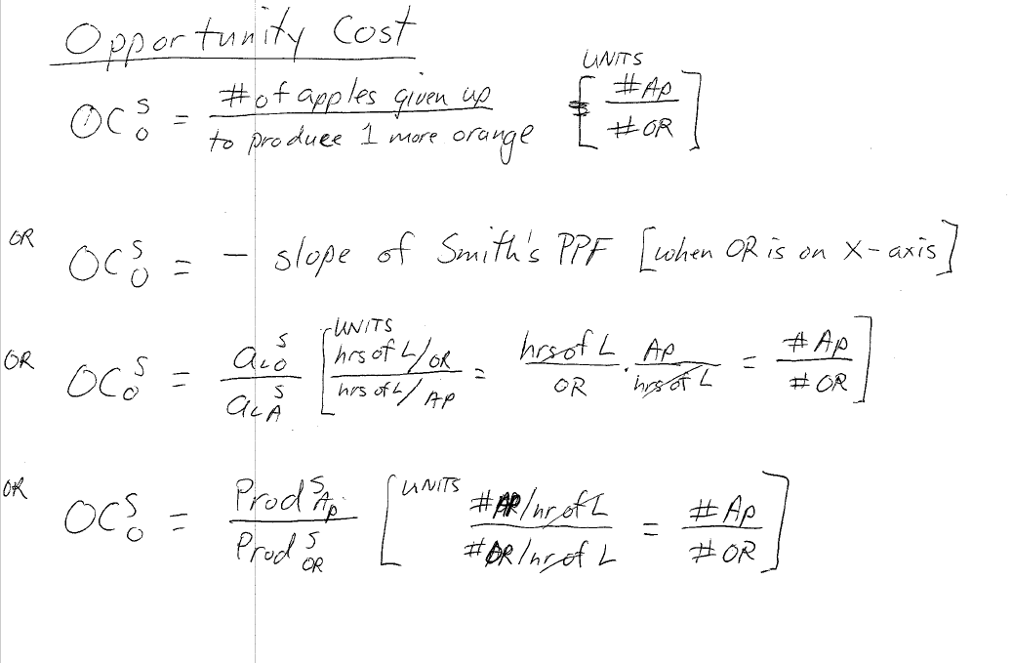

Slide 9
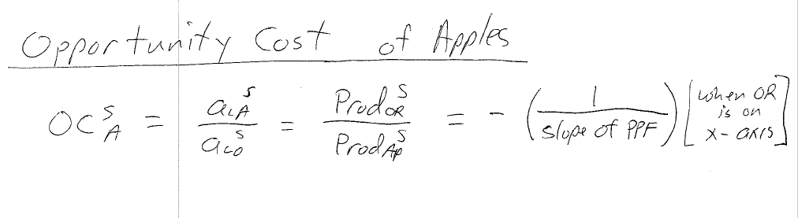

Slide 10
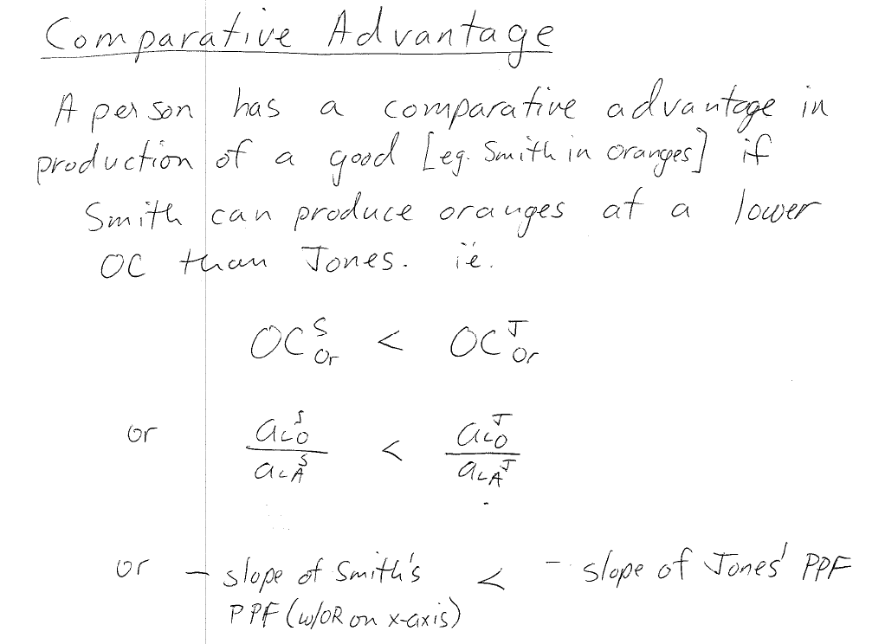

Slide 11
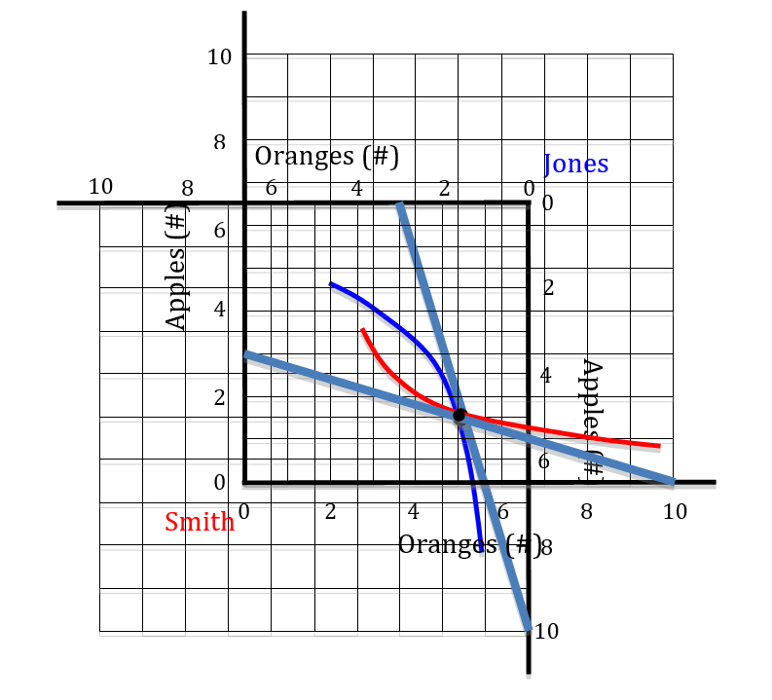
Autarky Production Edgeworth Box
Diagram assumes Smith and Jones come to a market after producing their autarky, utility-maximum, bundles.
EB (6.5 x 6.5 in size) is created by taking their autarky production points as their endowments.

Slide 12
Autarky Production Edgeworth Box
Because the two ICs form a lens → there are trades possible to increase utility for both.
The trading ToT value must lie between Smith’s Opp Cost of cheese (slope of Smith’s PPF) and Jones’ OC for cheese.
eg. 1 OR for 1 AP,
or 1.5 OR for 1.5 AP,
or 1.5 OR for 2 AP

Slide 13
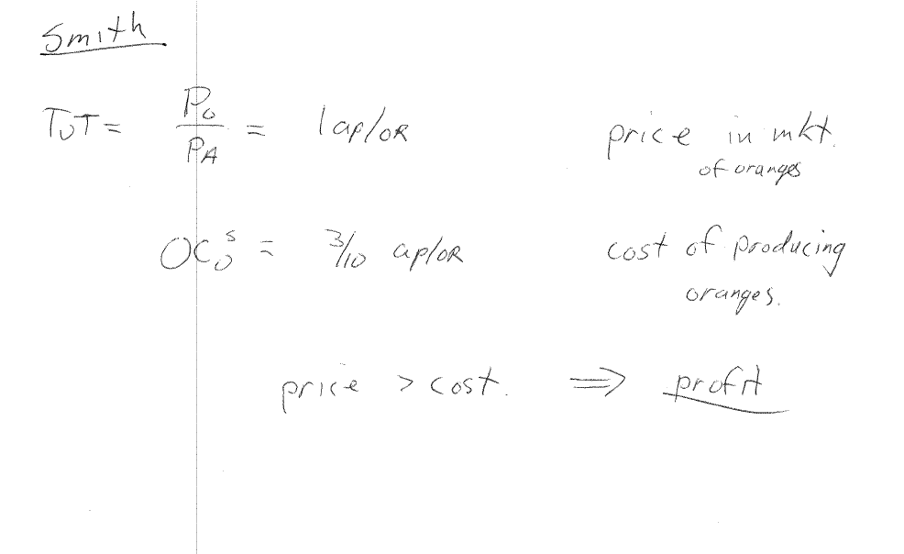

Slide 14
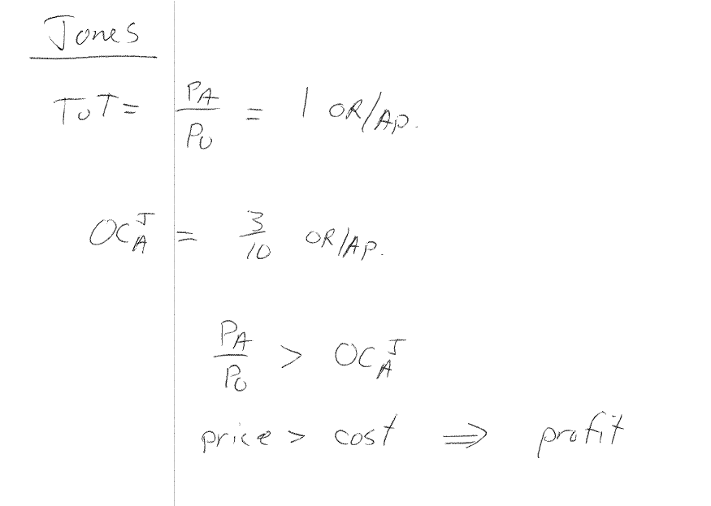

Slide 15
Motivation for Specialization and Trade
In the real world, identifying your CA good may be difficult
How to calculate OCs for every product?
In practice, firms must simply produce that which generates the greatest profit.
Produce more when Price > Cost
Produce less when Price < Cost
But, must still follow ethical constraints

Slide 16
Motivation for Specialization and Trade
Friedman’s suggestion that firms should only try to maximize profit (max shareholder value) is controversial
Critics believe it means that firms can do “anything” to make more money
But, Freidman said that profit maximization is constrained by the “rules of the game” i.e., ethics

Slide 17
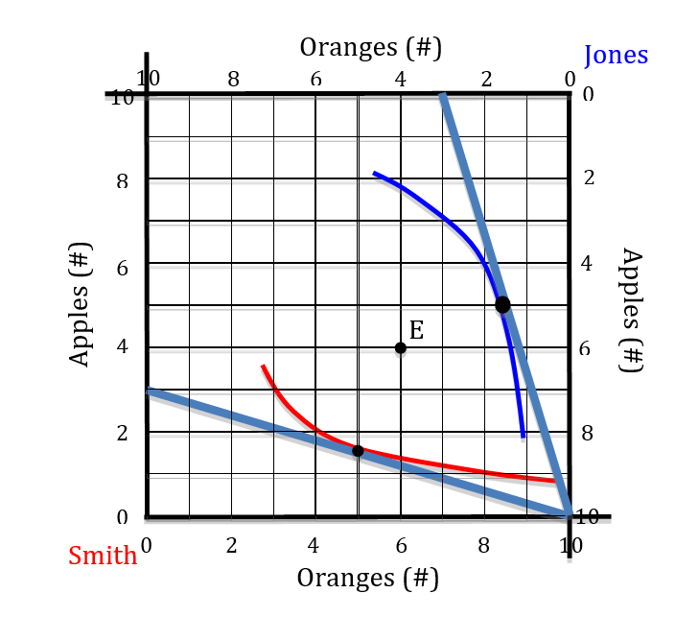
EB after Specialization in CA goods
Smith produces 10 oranges; Jones produces 10 apples
Specialization is inspired by desire for more profit/utility
EB is 10 x 10 and both traders’ utilities can rise substantially relative to autarky.
Increase in production efficiency because there is more of both goods available

Slide 18
EB after Specialization in CA goods
Because there are more of both goods with specialization, production efficiency increases.
Trade can occur to a point like E where the ToT = 1 Ap/Or
Note OCS < ToT < OCJ
A plausible ToT must satisfy above condition

Slide 19
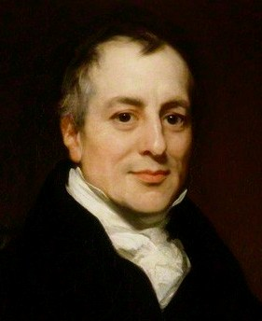
David Ricardo (1772-1823)
Discoverer/popularizer of the principle of Comparative Advantage
Our model of production and CA often called the Ricardian model.
“On the Principles of Political Economy and Taxation (1817)
Proponent of free trade

Slide 20
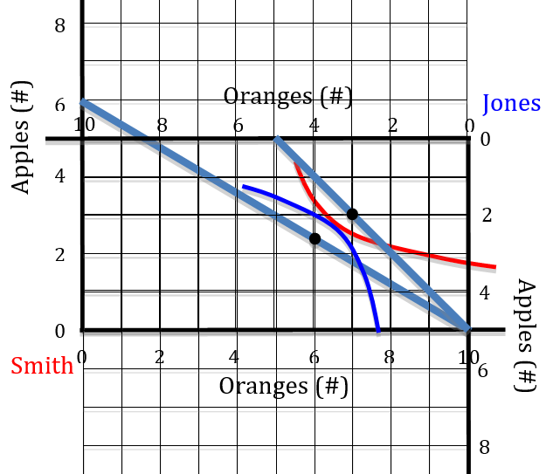
One person with no Absolute Advantage
Who has the absolute Adv in oranges? … in apples? Explain why.
What is each person’s Opp Cost? Include units.
Who has the CA in oranges? … in apples? Why?
Where is the specialization point?
What do the black dots on the PPFs represent?
What does the tangency of the two ICs represent?
What is a possible trading ToT?

Slide 21
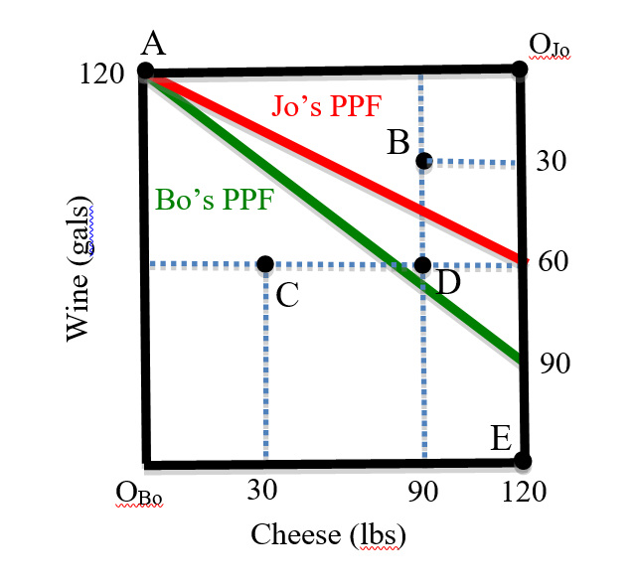
Examples from Problem Sets
This is an EB with production and specialization at A.
Diagram provides partial information .. To answer some questions requires making inferences
For example Bo’s productivity of cheese must be calculated using the info on the graph

Slide 22
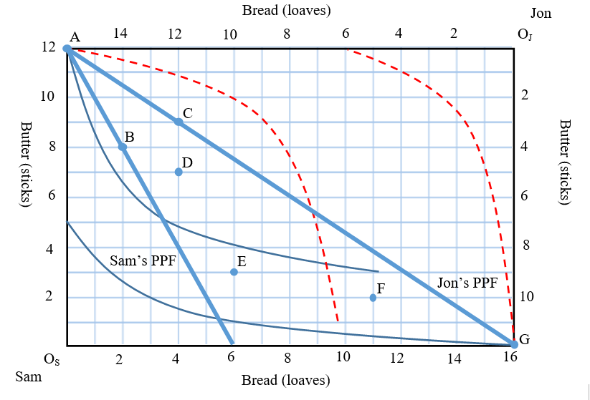
Examples from Problem Sets
This is an EB with production and specialization at A.
Diagram has PPFs and indifference curves drawn
Note whose origin is where. Note endpoints of each PPF, if shown
Note there are regions that are mutually beneficial that they would not choose

Slide 23
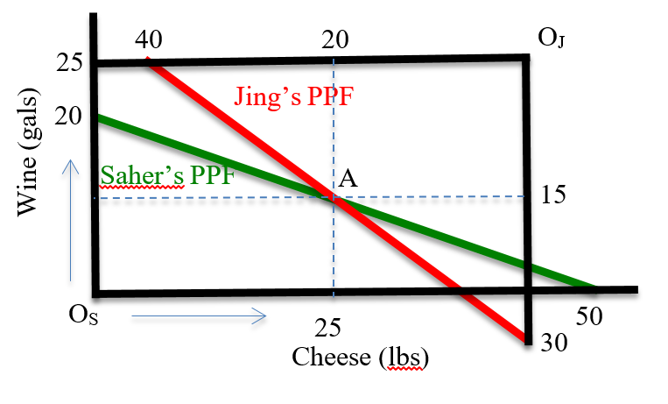
Examples from Problem Sets
This is an EB with production but no specialization at A (called diversification).
Note location of each person’s origin and PPF
Could you calculate the endpoints on the lower right if they weren’t listed?

